Slide 1
Satisfiability Modulo Theories solvers in Program Analysis and Verification
Leonardo de Moura and Nikolaj Bjørner
Microsoft Research

Slide 2
Tutorial overview
Appetizers
SMT solving
Applications
Some applications (at Microsoft Research)
Z3 – An Efficient SMT solver
Background
Basics, DPLL(∅), Equality, Arithmetic, DPLL(T), Arrays

Slide 3
SMT
Appetizer

Slide 4
Domains from programs
Bits and bytes
Numbers
Arrays
Records
Heaps
Data-types
Object inheritance

Slide 5
Satisfiability Modulo Theories (SMT)
Uninterpreted Functions
Array Theory
Arithmetic

Slide 6
ApplicationsAppetizer

Slide 7












Program Verification
Hyper-V
VCC
Boogie
Win. Modules
HAVOC
Verification
condition
Bug path
Rustan Leino, Mike Barnet, Michal Mosƙal, Shaz Qadeer, Shuvendu Lahiri, Herman Venter, Peter Muller,
Wolfram Schulte, Ernie Cohen

Slide 8






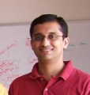

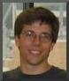
Test case generation
Run Test and Monitor
Execution Path
Path Condition
seed
Test Inputs
Known Paths
New input
Constraint System
Solve
Unexplored path
Vigilante
Nikolai Tillmann, Peli de Halleux, Patrice Godefroid
Aditya Nori, Jean Philippe Martin, Miguel Castro,
Manuel Costa, Lintao Zhang

Slide 9



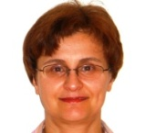


Static Driver Verifier
Z3 is part of SDV 2.0 (Windows 7)
It is used for:
Predicate abstraction (c2bp)
Counter-example refinement (newton)
Ella Bounimova, Vlad Levin, Jakob Lichtenberg,
Tom Ball, Sriram Rajamani, Byron Cook

Slide 10







More applications
Bounded model-checking of model programs
Termination
Security protocols, F#
Business application modeling
Cryptography
Model Based Testing (SQL-Server)
Verifying garbage collectors

Slide 11
Applications

Slide 12
Program Exploration with Pex

Slide 13
Z3 & Test case generation
Formulas may be a big conjunction
Pre-processing step
Eliminate variables and simplify input format
Incremental: solve several similar formulas
New constraints are asserted.
push and pop: (user) backtracking
Lemma reuse
“Small Models”
Given a formula F, find a model M, that minimizes the value of the variables x₀ … x_{n}

Slide 14
Spec# and Boogie

Slide 15
Verifying Compilers
A verifying compiler uses automated reasoning to check the
correctness of a program that is compiles.
Correctness is specified by types, assertions, . . . and other
redundant annotations that accompany the program.
Tony Hoare 2004

Slide 16
Spec# Approach for a Verifying Compiler
Source Language
C# + goodies = Spec#
Specifications
method contracts,
invariants,
field and type annotations.
Program Logic:
Dijkstra’s weakest preconditions.
Automatic Verification
type checking,
verification condition generation (VCG),
automatic theorem proving (SMT)
Spec# (annotated C#)
Spec# Compiler
Boogie PL
VC Generator
Formulas
Automatic Theorem Prover

Slide 17
Basic verifier architecture
Source language
Intermediate verification language
Verification condition (logical formula)

Slide 18
Verification architecture
Spec#
C
C
Dafny
Spec# compiler
Dafny verifier
vcc
HAVOC
MSIL
Bytecode translator
Boogie
Inference engine
Static program verifier (Boogie)
V.C. generator
Verification condition
SMT solver (Z3)
“correct” or list of errors

Slide 19
Modeling execution traces
terminates
…
diverges
goes wrong

Slide 20
States and execution traces
State
Cartesian product of variables
Execution trace
Nonempty finite sequence of states
Infinite sequence of states
Nonempty finite sequence of states followed by special error state
(x: int, y: int, z: bool)
…

Slide 21
Command language
x := E
x := x + 1
x := 10
havoc x
P
assert P
assume P
¬P
P

Slide 22
Command language
x := E
x := x + 1
x := 10
havoc x
S ; T
P
assert P
assume P
¬P
P
…
…

Slide 23
Command language
x := E
x := x + 1
x := 10
havoc x
S ; T
P
assert P
assume P
S T
¬P
P
…

Slide 24
Reasoning about execution traces
Hoare triple { P } S { Q } says that
every terminating execution trace of S that starts in a state satisfying P
does not go wrong, and
terminates in a state satisfying Q
Given P and Q, what is the largest S’ satisfying {P} S’ {Q} ?
to check {P} S {Q}, check S ⊆ S’

Slide 25
Reasoning about execution traces
Hoare triple { P } S { Q } says that
every terminating execution trace of S that starts in a state satisfying P
does not go wrong, and
terminates in a state satisfying Q
Given S and Q, what is the weakest P’ satisfying {P’} S {Q} ?
P' is called the weakest precondition of S with respect to Q, written wp(S, Q)
to check {P} S {Q}, check P ⇒ P’

Slide 26
Weakest preconditions
wp( x := E, Q ) =
wp( havoc x, Q ) =
wp( assert P, Q ) =
wp( assume P, Q ) =
wp( S ; T, Q ) =
wp( S T, Q ) =
Q[ E / x ]
(∀x • Q )
P ∧ Q
P ⇒ Q
wp( S, wp( T, Q ))
wp( S, Q ) ∧ wp( T, Q )

Slide 27
Structured if statement
if E then S else T end =
assume E; S
assume ¬E; T

Slide 28
Dijkstra's guarded command
if E → S | F → T fi =
assert E ∨ F;
(
assume E; S
assume F; T
)

Slide 29
Picking any good value
assign x such that P =
havoc x; assume P
assign x such that x*x = y
P
;
=
¬P

Slide 30
Procedures
A procedure is a user-defined command
procedure M(x, y, z) returns (r, s, t) requires P modifies g, h ensures Q

Slide 31
Procedure example
procedure Inc(n) returns (b) requires 0 ≤ n modifies g ensures g = old(g) + n

Slide 32
Procedures
A procedure is a user-defined command
procedure M(x, y, z) returns (r, s, t) requires P modifies g, h ensures Q
call a, b, c := M(E, F, G) = x’ := E; y’ := F; z’ := G; assert P’; g0 := g; h0 := h; havoc g, h, r’, s’, t’; assume Q’; a := r’; b := s’; c := t’
where
x’, y’, z’, r’, s’, t’, g0, h0 are fresh names
P’ is P with x’,y’,z’ for x,y,z
Q’ is Q with x’,y’,z’,r’,s’,t’,g0,h0 for x,y,z,r,s,t, old(g), old(h)

Slide 33
Procedure implementations
procedure M(x, y, z) returns (r, s, t) requires P modifies g, h ensures Q
implementation M(x, y, z) returns (r, s, t) is S
= assume P; g0 := g; h0 := h;
S; assert Q’
where
g0, h0 are fresh names
Q’ is Q with g0,h0 for old(g), old(h)
syntactically check that S assigns only to g,h

Slide 34
While loop with loop invariant
while E invariant J do S end
= assert J; havoc x; assume J; ( assume E; S; assert J; assume false assume ¬E )
where x denotes the assignment targets of S
check that the loop invariant holds initially
“fast forward” to an arbitrary iteration of the loop
check that the loop invariant is maintained by the loop body

Slide 35
Properties of the heap
introduce:
axiom (∀ h: HeapType, o: Ref, f: Field Ref • o ≠ null ∧ h[o, alloc] ⇒ h[o, f] = null ∨ h[ h[o,f], alloc ] );

Slide 36
Properties of the heap
introduce:
function IsHeap(HeapType) returns (bool);
introduce:
axiom (∀ h: HeapType, o: Ref, f: Field Ref • IsHeap(h) ∧ o ≠ null ∧ h[o, alloc] ⇒ h[o, f] = null ∨ h[ h[o,f], alloc ] );
introduce: assume IsHeap(Heap) after each Heap update; for example: Tr[[ E.x := F ]] = assert …; Heap[…] := …; assume IsHeap(Heap)

Slide 37
Methods
method M(x: X) returns (y: Y) requires P; modifies S; ensures Q; { Stmt }
procedure M(this: Ref, x: Ref) returns (y: Ref);
free requires IsHeap(Heap); free requires this ≠ null ∧ Heap[this, alloc]; free requires x = null ∨ Heap[x, alloc];
requires Df[[ P ]] ∧ Tr[[ P ]];
requires Df[[ S ]];
modifies Heap;
ensures Df[[ Q ]] ∧ Tr[[ Q ]];
ensures (∀⟨α⟩ o: Ref, f: Field α • o ≠ null ∧ old(Heap)[o,alloc] ⇒ Heap[o,f] = old(Heap)[o,f] ∨ (o,f) ∈ old( Tr[[ S ]] ));
free ensures IsHeap(Heap); free ensures y = null ∨ Heap[y, alloc]; free ensures (∀o: Ref • old(Heap)[o,alloc] ⇒ Heap[o,alloc]);

Slide 38
Spec# Chunker.NextChunk translation
procedure Chunker.NextChunk(this: ref where $IsNotNull(this, Chunker)) returns ($result: ref where $IsNotNull($result, System.String));
// in-parameter: target object
free requires $Heap[this, $allocated];
requires ($Heap[this, $ownerFrame] == $PeerGroupPlaceholder || !($Heap[$Heap[this, $ownerRef], $inv] <: $Heap[this, $ownerFrame]) || $Heap[$Heap[this, $ownerRef], $localinv] == $BaseClass($Heap[this, $ownerFrame])) && (forall $pc: ref :: $pc != null && $Heap[$pc, $allocated] && $Heap[$pc, $ownerRef] == $Heap[this, $ownerRef] && $Heap[$pc, $ownerFrame] == $Heap[this, $ownerFrame] ==> $Heap[$pc, $inv] == $typeof($pc) && $Heap[$pc, $localinv] == $typeof($pc));
// out-parameter: return value
free ensures $Heap[$result, $allocated];
ensures ($Heap[$result, $ownerFrame] == $PeerGroupPlaceholder || !($Heap[$Heap[$result, $ownerRef], $inv] <: $Heap[$result, $ownerFrame]) || $Heap[$Heap[$result, $ownerRef], $localinv] == $BaseClass($Heap[$result, $ownerFrame])) && (forall $pc: ref :: $pc != null && $Heap[$pc, $allocated] && $Heap[$pc, $ownerRef] == $Heap[$result, $ownerRef] && $Heap[$pc, $ownerFrame] == $Heap[$result, $ownerFrame] ==> $Heap[$pc, $inv] == $typeof($pc) && $Heap[$pc, $localinv] == $typeof($pc));
// user-declared postconditions
ensures $StringLength($result) <= $Heap[this, Chunker.ChunkSize];
// frame condition
modifies $Heap;
free ensures (forall $o: ref, $f: name :: { $Heap[$o, $f] } $f != $inv && $f != $localinv && $f != $FirstConsistentOwner && (!IsStaticField($f) || !IsDirectlyModifiableField($f)) && $o != null && old($Heap)[$o, $allocated] && (old($Heap)[$o, $ownerFrame] == $PeerGroupPlaceholder || !(old($Heap)[old($Heap)[$o, $ownerRef], $inv] <: old($Heap)[$o, $ownerFrame]) || old($Heap)[old($Heap)[$o, $ownerRef], $localinv] == $BaseClass(old($Heap)[$o, $ownerFrame])) && old($o != this || !(Chunker <: DeclType($f)) || !$IncludedInModifiesStar($f)) && old($o != this || $f != $exposeVersion) ==> old($Heap)[$o, $f] == $Heap[$o, $f]);
// boilerplate
free requires $BeingConstructed == null;
free ensures (forall $o: ref :: { $Heap[$o, $localinv] } { $Heap[$o, $inv] } $o != null && !old($Heap)[$o, $allocated] && $Heap[$o, $allocated] ==> $Heap[$o, $inv] == $typeof($o) && $Heap[$o, $localinv] == $typeof($o));
free ensures (forall $o: ref :: { $Heap[$o, $FirstConsistentOwner] } old($Heap)[old($Heap)[$o, $FirstConsistentOwner], $exposeVersion] == $Heap[old($Heap)[$o, $FirstConsistentOwner], $exposeVersion] ==> old($Heap)[$o, $FirstConsistentOwner] == $Heap[$o, $FirstConsistentOwner]);
free ensures (forall $o: ref :: { $Heap[$o, $localinv] } { $Heap[$o, $inv] } old($Heap)[$o, $allocated] ==> old($Heap)[$o, $inv] == $Heap[$o, $inv] && old($Heap)[$o, $localinv] == $Heap[$o, $localinv]);
free ensures (forall $o: ref :: { $Heap[$o, $allocated] } old($Heap)[$o, $allocated] ==> $Heap[$o, $allocated]) && (forall $ot: ref :: { $Heap[$ot, $ownerFrame] } { $Heap[$ot, $ownerRef] } old($Heap)[$ot, $allocated] && old($Heap)[$ot, $ownerFrame] != $PeerGroupPlaceholder ==> old($Heap)[$ot, $ownerRef] == $Heap[$ot, $ownerRef] && old($Heap)[$ot, $ownerFrame] == $Heap[$ot, $ownerFrame]) && old($Heap)[$BeingConstructed, $NonNullFieldsAreInitialized] == $Heap[$BeingConstructed, $NonNullFieldsAreInitialized];

Slide 39
Z3 & Program Verification
Quantifiers, quantifiers, quantifiers, …
Modeling the runtime
Frame axioms (“what didn’t change”)
Users provided assertions (e.g., the array is sorted)
Prototyping decision procedures (e.g., reachability, heaps, …)
Solver must be fast in satisfiable instances.
Trade-off between precision and performance.
Candidate (Potential) Models

Slide 40
A verifying C compiler

Slide 41
HAVOC
Verifying Windows Components

Slide 42
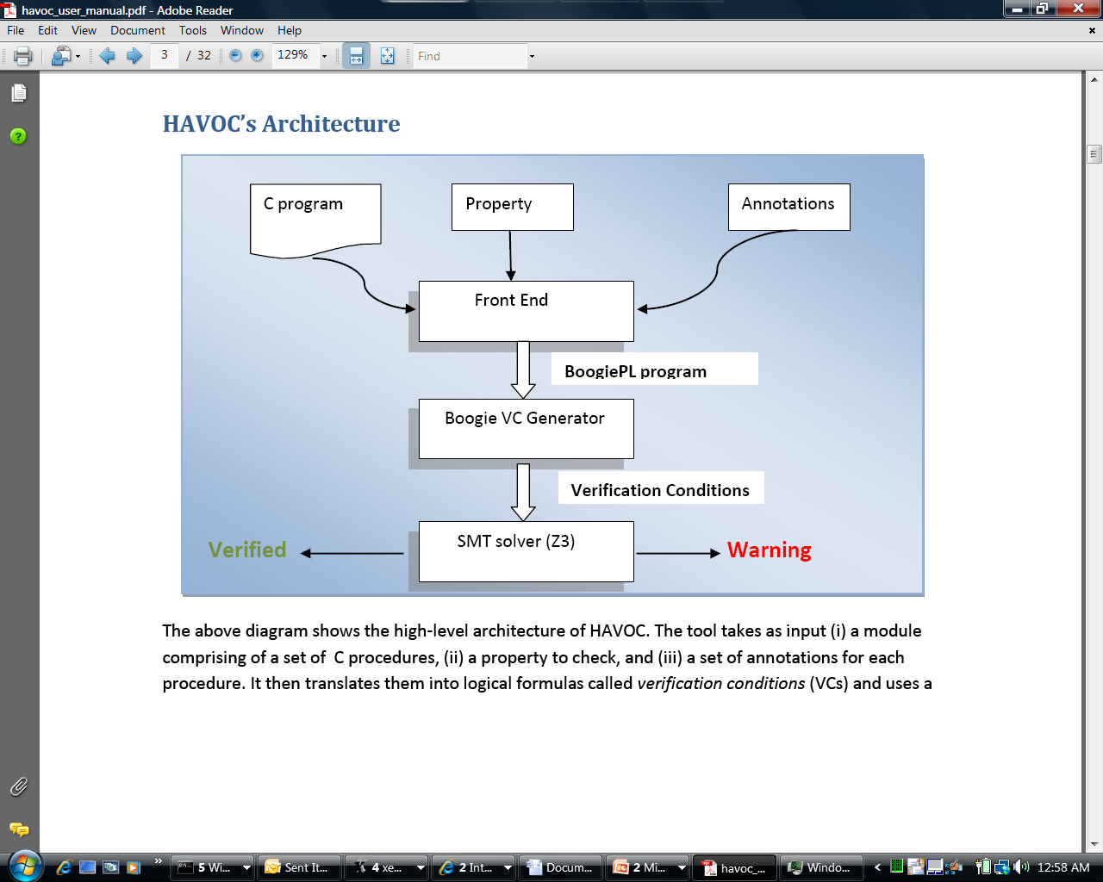
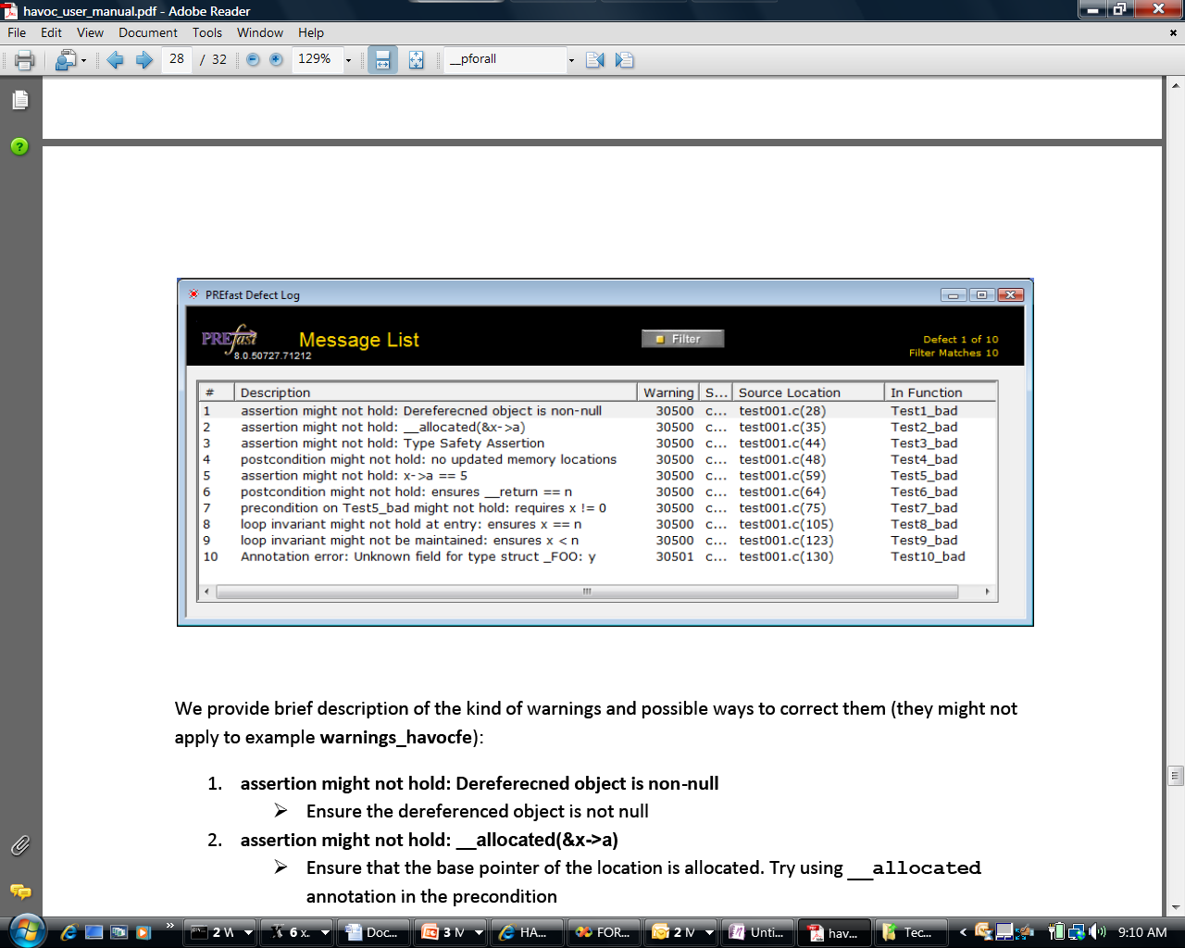
HAVOC's Architecture

Slide 43
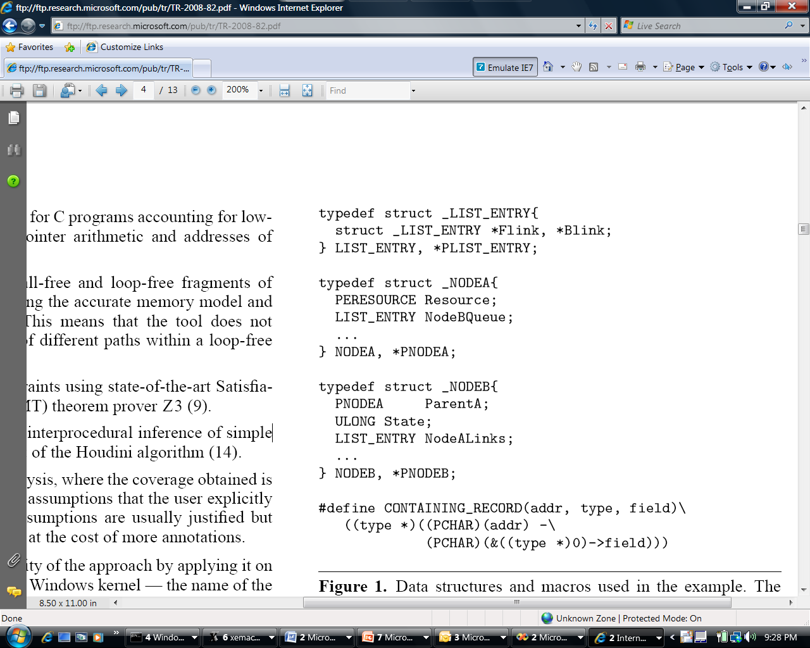
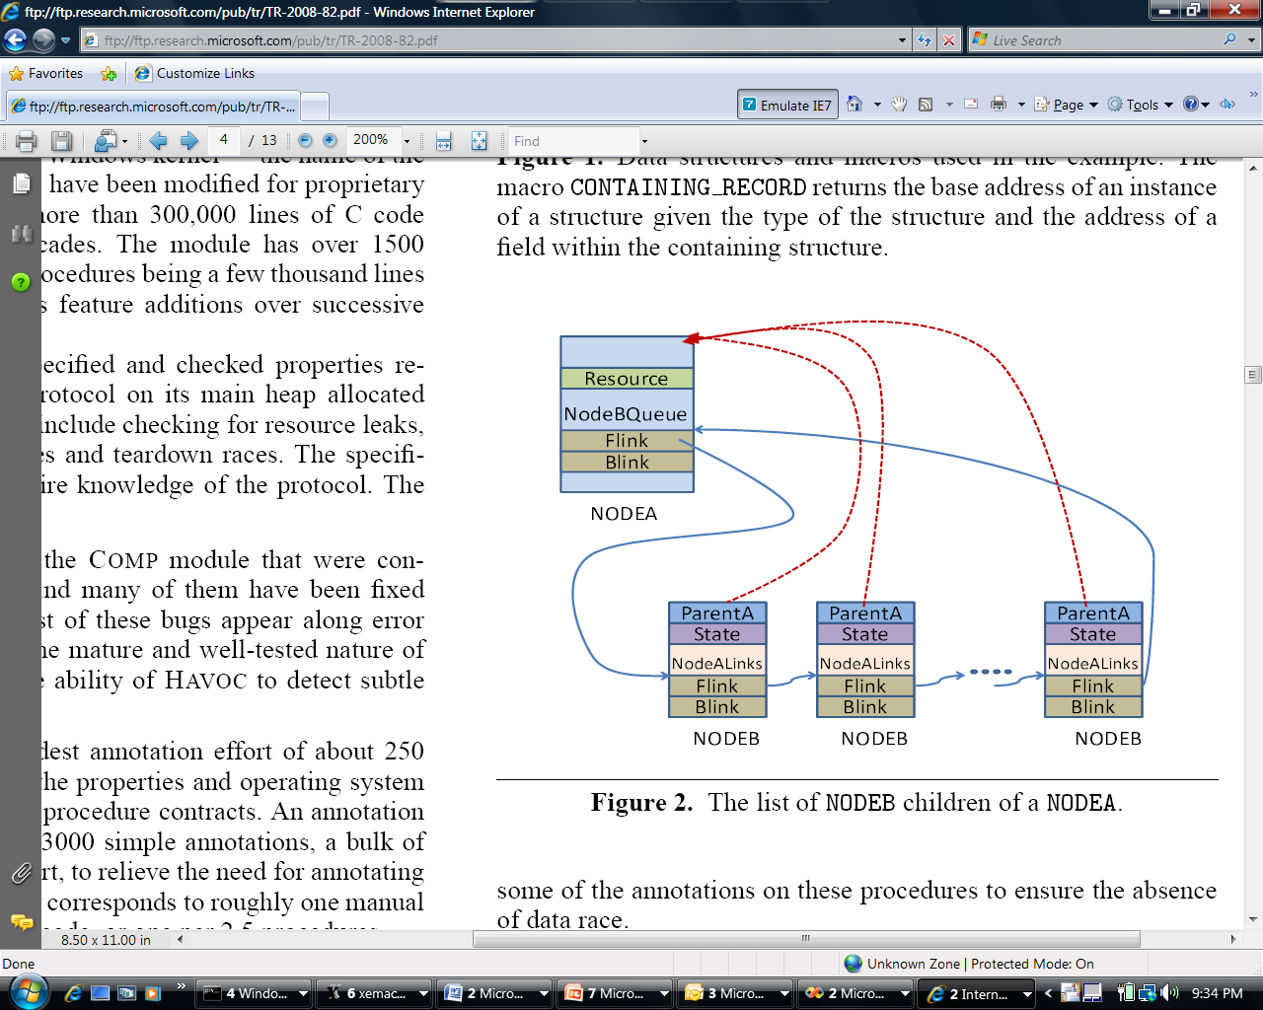
Heaps and Shapes
Representative shape graph in Windows Kernel component
Doubly linked lists in Windows Kernel code

Slide 44

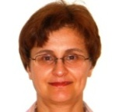
The Static Driver Verifier
SLAM
Ella Bounimova, Vlad Levin, Jakob Lichtenberg,
Tom Ball, Sriram Rajamani, Byron Cook

Slide 45
Overview
http://research.microsoft.com/slam/
SLAM/SDV is a software model checker.
Application domain: device drivers.
Architecture:
c2bp C program → boolean program (predicate abstraction).
bebop Model checker for boolean programs.
newton Model refinement (check for path feasibility)
SMT solvers are used to perform predicate abstraction and to check path feasibility.
c2bp makes several calls to the SMT solver. The formulas are relatively small.

Slide 46
Example
Do this code obey the looking rule?
do {
KeAcquireSpinLock();
nPacketsOld = nPackets;
if(request){
request = request->Next;
KeReleaseSpinLock();
nPackets++;
}
} while (nPackets != nPacketsOld);
KeReleaseSpinLock();

Slide 47
Example
Model checking Boolean program
U
do {
KeAcquireSpinLock();
if(*){
KeReleaseSpinLock();
}
} while (*);
KeReleaseSpinLock();
L
L
L
U
L
U
L
U
U
E

Slide 48
Example
Is error path feasible?
U
do {
KeAcquireSpinLock();
nPacketsOld = nPackets;
if(request){
request = request->Next;
KeReleaseSpinLock();
nPackets++;
}
} while (nPackets != nPacketsOld);
KeReleaseSpinLock();
L
L
L
U
L
U
L
U
U
E

Slide 49
Example
Add new predicate to
Boolean program
b: (nPacketsOld == nPackets)
U
do {
KeAcquireSpinLock();
nPacketsOld = nPackets;
if(request){
request = request->Next;
KeReleaseSpinLock();
nPackets++;
}
} while (nPackets != nPacketsOld);
KeReleaseSpinLock();
L
b = true;
L
L
U
b = b ? false : *;
L
U
!b
L
U
U
E

Slide 50
Example
Model Checking
Refined Program
b: (nPacketsOld == nPackets)
U
do {
KeAcquireSpinLock();
b = true;
if(*){
KeReleaseSpinLock();
b = b ? false : *;
}
} while (!b);
KeReleaseSpinLock();
L
b
L
L
b
U
b
b
L
U
!b
b
L
U
b
U
E

Slide 51
Example
Model Checking
Refined Program
b: (nPacketsOld == nPackets)
U
do {
KeAcquireSpinLock();
b = true;
if(*){
KeReleaseSpinLock();
b = b ? false : *;
}
} while (!b);
KeReleaseSpinLock();
L
b
L
L
b
U
b
b
L
U
!b
b
L
b
U

Slide 52
Observations about SLAM
Automatic discovery of invariants
driven by property and a finite set of (false) execution paths
predicates are not invariants, but observations
abstraction + model checking computes inductive invariants (boolean combinations of observations)
A hybrid dynamic/static analysis
newton executes path through C code symbolically
c2bp+bebop explore all paths through abstraction
A new form of program slicing
program code and data not relevant to property are dropped
non-determinism allows slices to have more behaviors

Slide 53
Syntatic Sugar
goto L1, L2;
L1: assume(e);
S1;
goto L3;
L2: assume(!e);
S2;
goto L3;
L3: S3;
if (e) {
S1;
} else {
S2;
}
S3;

Slide 54
Predicate Abstraction: c2bp
Given a C program P and F = {p₁, … , p_{n}}.
Produce a Boolean program B(P, F)
Same control flow structure as P.
Boolean variables {b₁, … , b_{n}} to match {p₁, … , p_{n}}.
Properties true in B(P, F) are true in P.
Each p_{i} is a pure Boolean expression.
Each p_{i} represents set of states for which p_{i} is true.
Performs modular abstraction.

Slide 55
Abstracting Assignments via WP
Statement y=y+1 and F={ y<4, y<5 }
{y<4}, {y<5} = ((!{y<5} || !{y<4}) ? false : *), {y<4})
WP(x=e,Q) = Q[x -> e]
WP(y=y+1, y<5) =
(y<5) [y -> y+1] =
(y+1<5) =
(y<4)

Slide 56
WP Problem
WP(s, p_{i}) is not always expressible via {p₁, …, p_{n}}
Example:
F = { x==0, x==1, x < 5}
WP(x = x+1, x < 5) = x < 4

Slide 57
Abstracting Expressions via F
Implies_{F} (e)
Best Boolean function over F that implies e.
ImpliedBy_{F} (e)
Best Boolean function over F that is implied by e.
ImpliedBy_{F} (e) = not Implies_{F} (not e)

Slide 58
Implies_{F}(e) and ImpliedBy_{F}(e)
e
ImpliedBy_{F}(e)
Implies_{F}(e)

Slide 59
Computing Implies_{F}(e)
minterm m = l₁ ∧ ... ∧ l_{n}, where l_{i} = p_{i}, or l_{i} = not p_{i}.
Implies_{F} (e): disjunction of all minterms that imply e.
Naive approach
Generate all 2^{n} possible minterms.
For each minterm m, use SMT solver to check validity of m ⇒ e.
Many possible optimizations

Slide 60
Computing Implies_{F}(e)
F = { x < y, x = 2}
e : y > 1
Minterms over F
!x<y, !x=2 implies y>1
x<y, !x=2 implies y>1
!x<y, x=2 implies y>1
x<y, x=2 implies y>1
Implies_{F}(y>1) = x<y, x=2

Slide 61
Abstracting Assignments
if Implies_{F}(WP(s, p_{i})) is true before s then
p_{i} is true after s
if Implies_{F}(WP(s, !p_{i})) is true before s then
p_{i} is false after s
{p_{i}} = Implies_{F}(WP(s, p_{i})) ? true :
Implies_{F}(WP(s, !p_{i})) ? false
: *;

Slide 62
Assignment Example
Statement: y = y + 1 Predicates: {x == y}
Weakest Precondition:
WP(y = y + 1, x==y) = x == y + 1
Implies_{F}( x==y+1 ) = false
Implies_{F}( x!=y+1 ) = x==y
Abstraction of y = y +1
{x == y} = {x == y} ? false : *;

Slide 63
Abstracting Assumes
WP(assume(e), Q) = e implies Q
assume(e) is abstracted to:
assume( ImpliedBy_{F}(e) )
Example:
F = {x==2, x<5}
assume(x < 2) is abstracted to:
assume( {x<5} && !{x==2} )

Slide 64
Newton
Given an error path p in the Boolean program B.
Is p a feasible path of the corresponding C program?
Yes: found a bug.
No: find predicates that explain the infeasibility.
Execute path symbolically.
Check conditions for inconsistency using SMT solver.

Slide 65
Z3 & Static Driver Verifier
All-SAT
Fast Predicate Abstraction
Unsatisfiable cores
Why the abstract path is not feasible?

Slide 66
Synergy
Combining Random Testing with Model Checking

Slide 67
TBD
Prune this shamelessly stolen material into core essence that relates to using the theorem prover.

Slide 68
Synergy – sketch
Input:
Program P
Property ψ
Construct random tests
Construct initial proof
Test succeeded?
yes
Bug!
no
Proof succeeded?
yes
Proof!
no
τ = error path in failed proof
f = frontier of error path
Can extend test beyond frontier?
yes
no
Refine proof

Slide 69
Example
Does this program obey the locking rule?
void foo(int y)
{
1: do {
2: lock();
3: x = y;
4: if (*) {
5: unlock();
6: y = y + 1;
}
7: } while (x != y);
8: unlock();
}

Slide 70
Example
void foo(int y)
{
1: do {
2: lock();
3: x = y;
4: if (*) {
5: unlock();
6: y = y + 1;
}
7: } while (x != y);
8: unlock();
}

Slide 71
Example
Input:
Program P
Property ψ
Construct random tests
Construct initial proof
void foo(int y)
{
1: do {
2: lock();
3: x = y;
4: if (*) {
5: unlock();
6: y = y + 1;
}
7: } while (x != y);
8: unlock();
}
Test succeeded?
yes
Bug!
no
Proof succeeded?
yes
Proof!
no
τ = error path in failed proof
f = frontier of error path
Can extend test beyond frontier?
yes
no
Refine proof

Slide 72
Example
0
Input:
Program P
Property ψ
×
y = 1
1
Construct random tests
Construct initial proof
void foo(int y)
{
1: do {
2: lock();
3: x = y;
4: if (*) {
5: unlock();
6: y = y + 1;
}
7: } while (x != y);
8: unlock();
}
×
×
2
×
×
Test succeeded?
yes
Bug!
3
no
×
×
Proof succeeded?
yes
Proof!
4
no
×
×
τ = error path in failed proof
f = frontier of error path
5
7
Can extend test beyond frontier?
×
×
×
yes
6
8
no
×
×
Refine proof
9

Slide 73
Example
0
Input:
Program P
Property ψ
×
y = 1
1
Construct random tests
Construct initial proof
void foo(int y)
{
1: do {
2: lock();
3: x = y;
4: if (*) {
5: unlock();
6: y = y + 1;
}
7: } while (x != y);
8: unlock();
}
×
×
2
×
×
Test succeeded?
yes
Bug!
3
no
×
×
Proof succeeded?
yes
Proof!
4
no
×
×
τ = error path in failed proof
f = frontier of error path
5
7
Can extend test beyond frontier?
×
×
×
yes
6
8
no
×
×
Refine proof
τ=(0,1,2,3,4,7,8,9)
9
frontier

Slide 74
Example
0
Input:
Program P
Property ψ
×
1
Construct random tests
Construct initial proof
void foo(int y)
{
1: do {
2: lock();
3: x = y;
4: if (*) {
5: unlock();
6: y = y + 1;
}
7: } while (x != y);
8: unlock();
}
×
×
2
×
×
Test succeeded?
yes
Bug!
3
no
×
×
Proof succeeded?
yes
Proof!
4
no
×
×
τ = error path in failed proof
f = frontier of error path
5
7
Can extend test beyond frontier?
×
×
×
yes
6
8⋀p
8⋀¬p
no
×
×
×
Refine proof
split <pc=8> into two regions wrt p= (lock.state != L)
9

Slide 75
Example
0
Input:
Program P
Property ψ
×
1
Construct random tests
Construct initial proof
void foo(int y)
{
1: do {
2: lock();
3: x = y;
4: if (*) {
5: unlock();
6: y = y + 1;
}
7: } while (x != y);
8: unlock();
}
×
×
2
×
×
Test succeeded?
yes
Bug!
3
no
×
×
Proof succeeded?
yes
Proof!
4
no
×
×
τ = error path in failed proof
f = frontier of error path
5
7
Can extend test beyond frontier?
×
×
×
yes
6
8⋀p
8⋀¬p
no
×
×
×
Refine proof
τ=(0,1,2,3,4,7,<8,p>,9)
9
frontier

Slide 76

Correct, the program is
0
×
1
void foo(int y)
{
1: do {
2: lock();
3: x = y;
4: if (*) {
5: unlock();
6: y = y + 1;
}
7: } while (x != y);
8: unlock();
}
×
×
2
×
×
3
×
×
4⋀¬s
4⋀s
×
×
5⋀¬s
5⋀s
×
6⋀¬r
6⋀r
×
7⋀¬q
7⋀q
×
×
8⋀p
8⋀¬p
9
×

Slide 77
Example
Input:
Program P
Property ψ
0
Construct random tests
Construct initial proof
void foo(int a)
{
0: i = 0;
1: c = 0;
2: while (i < 1000)
{
3: c = c + i;
4: i = i + 1;
}
5: if (a <= 0)
6: error();
}
1
2
Test succeeded?
yes
Bug!
no
3
Proof succeeded?
yes
Proof!
no
4
τ = error path in failed proof
f = frontier of error path
Can extend test beyond frontier?
5
yes
no
6
Refine proof

Slide 78
Example
Input:
Program P
Property ψ
0
a = 45
×
×
Construct random tests
Construct initial proof
void foo(int a)
{
0: i = 0;
1: c = 0;
2: while (i < 1000)
{
3: c = c + i;
4: i = i + 1;
}
5: if (a <= 0)
6: error();
}
1
×
×
2
Test succeeded?
yes
Bug!
×
×
no
3
Proof succeeded?
yes
Proof!
×
×
no
4
τ = error path in failed proof
f = frontier of error path
×
×
Can extend test beyond frontier?
5
yes
×
×
no
6
Refine proof

Slide 79
Example
Input:
Program P
Property ψ
0
×
×
Construct random tests
Construct initial proof
void foo(int a)
{
0: i = 0;
1: c = 0;
2: while (i < 1000)
{
3: c = c + i;
4: i = i + 1;
}
5: if (a <= 0)
6: error();
}
1
×
×
2
Test succeeded?
yes
Bug!
×
×
no
3
Proof succeeded?
yes
Proof!
×
×
no
4
τ = error path in failed proof
f = frontier of error path
×
×
Can extend test beyond frontier?
5
yes
×
×
no
a = -5
6
Refine proof
×

Slide 80
Synergy solver requirements
Maintain set L of program locations.
Map L to symbolic partition.
Represented as formulas.
Check for subsumption.
Check for contradiction.
Structure sharing

Slide 81
Better Bug Reporting with
Better Privacy
Also: Vigilante – Internet Worm Containment

Slide 82
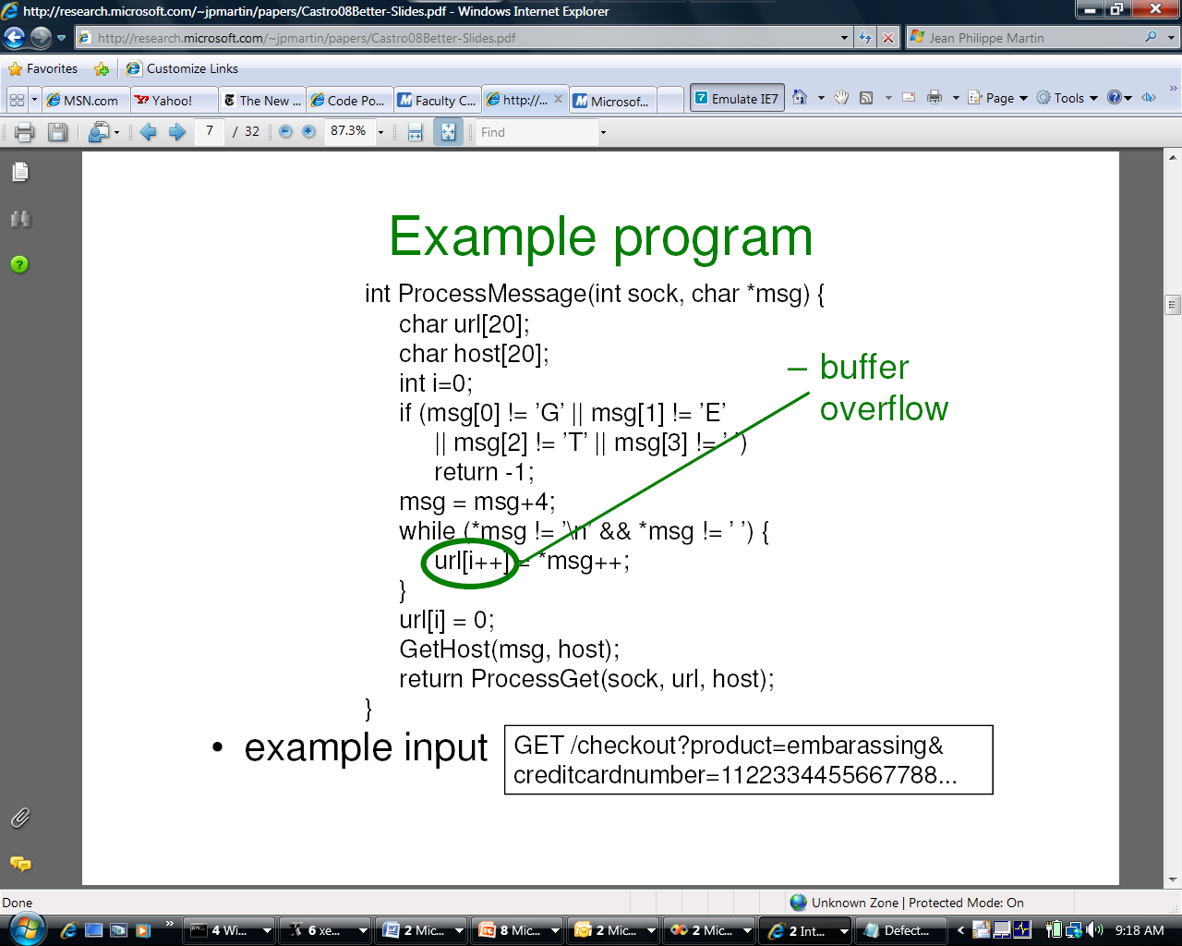
Replay Execution
Extract Path Condition
Solve Path Condition
(with Z3)
Compute Bits Revealed
teddybear
00102220344011100

Slide 83
Program Termination
Byron Cook
http://www.foment.net/byron/fsharp.shtml
A complete method for the synthesis of linear ranking functions. Podelski &Rybalchenkoy; VMCAI 04
"

Slide 84
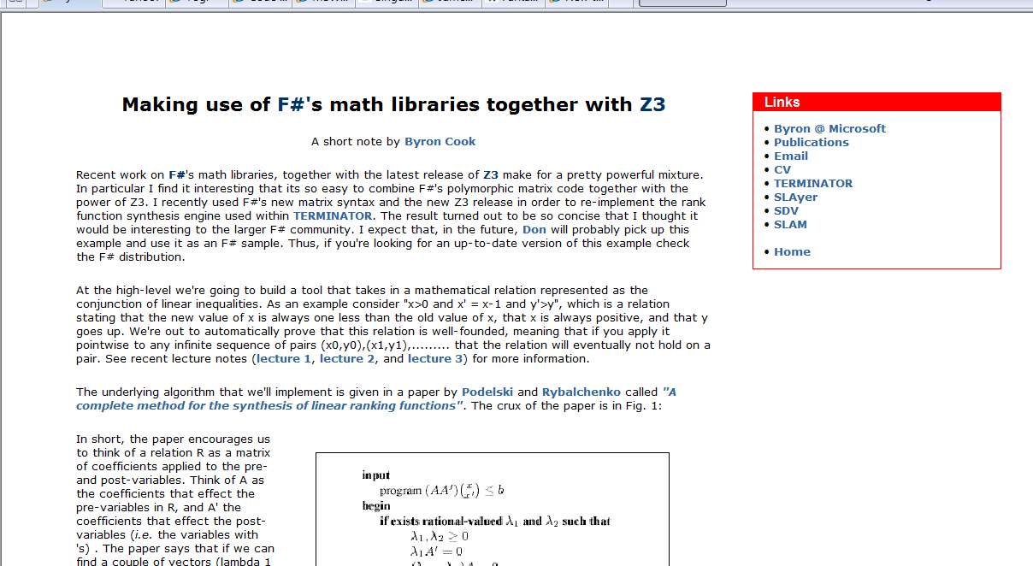
Form Byron Cook's blog

Slide 85
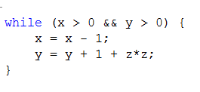
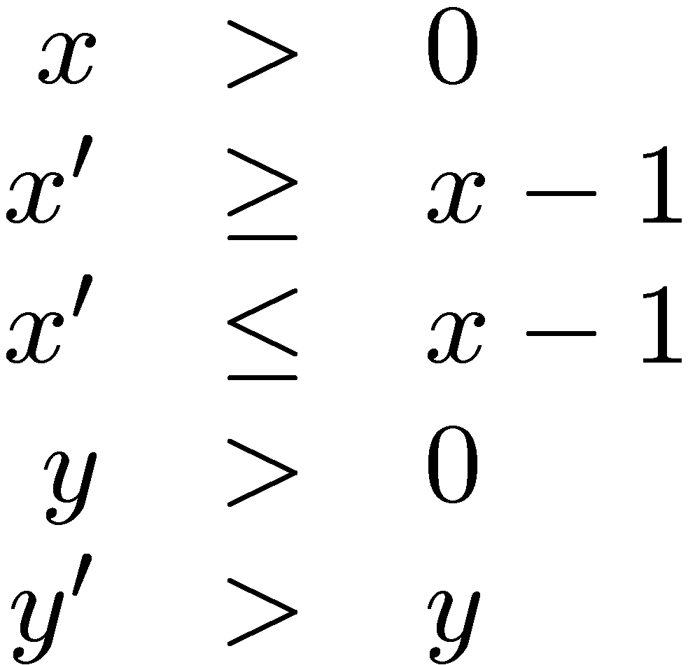
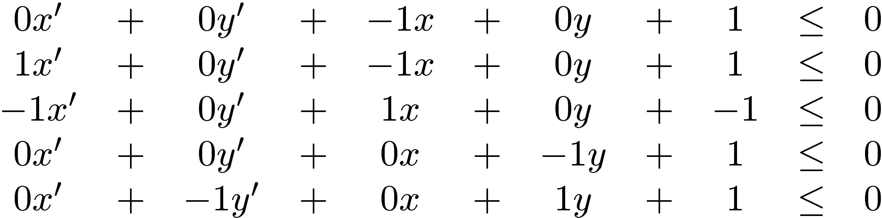
Does this program Terminate?

Slide 86

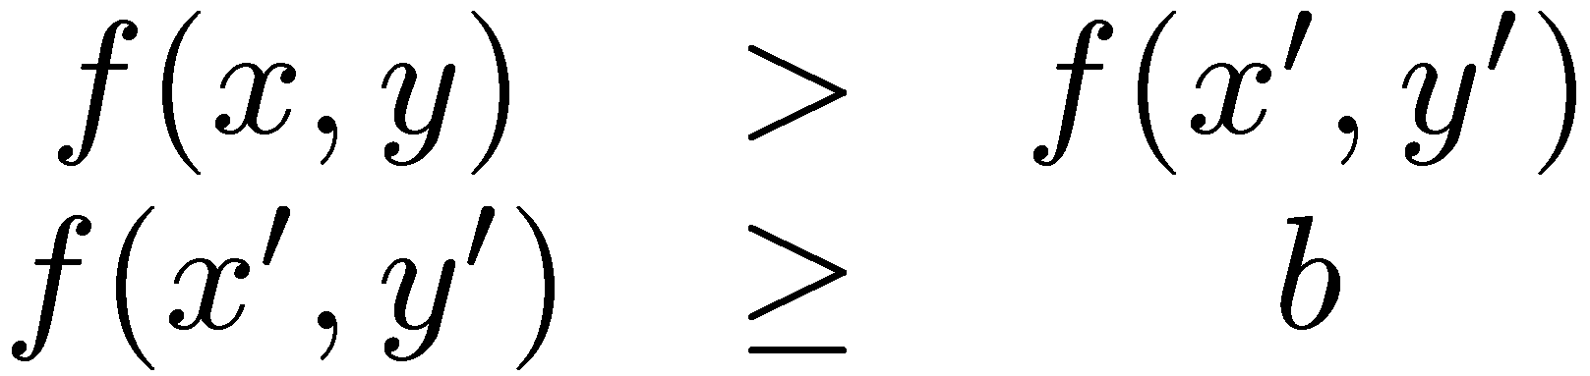
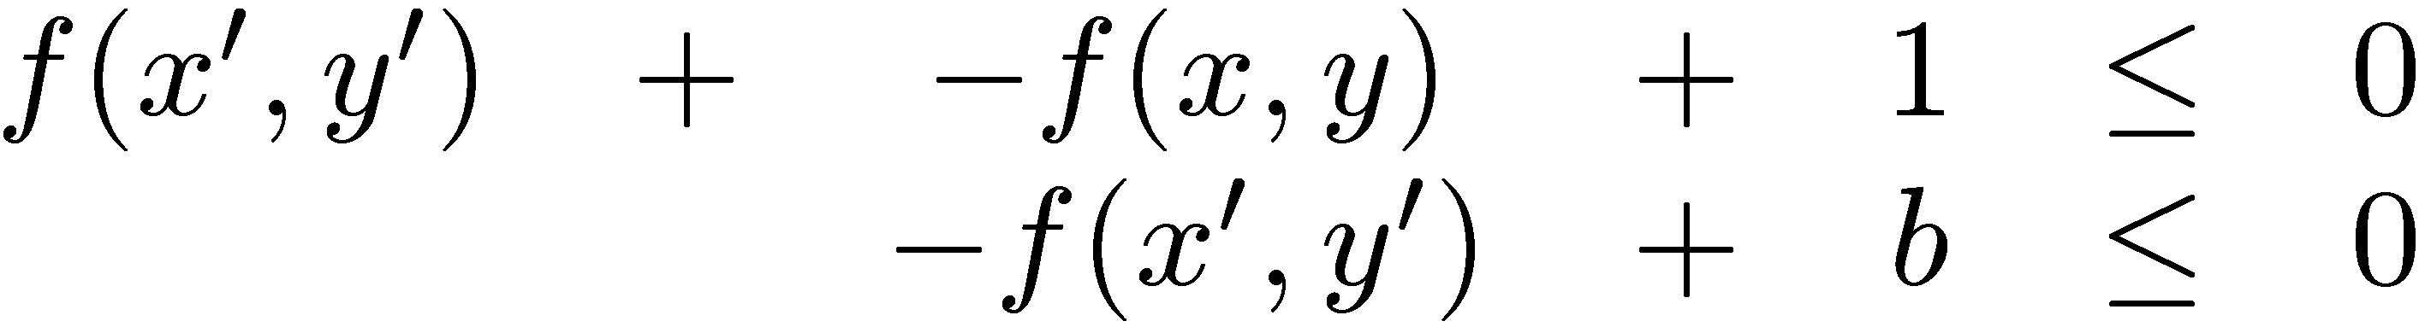
Rank function synthesis
Can we find f, b,
such that the
inclusion holds?
That is:

Slide 87
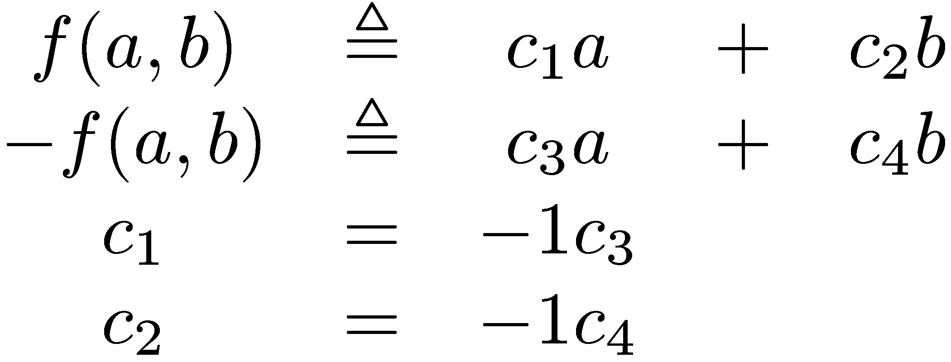
Rank function synthesis
Search over linear templates:

Slide 88
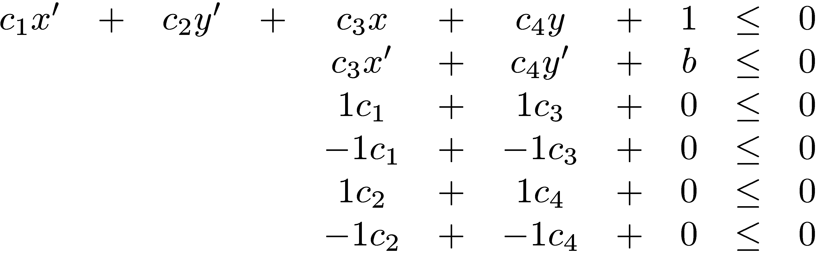
Rank function synthesis
Find
Search over linear templates:

Slide 89
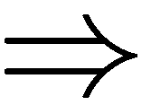
Rank function synthesis
Search over linear templates:

Slide 90
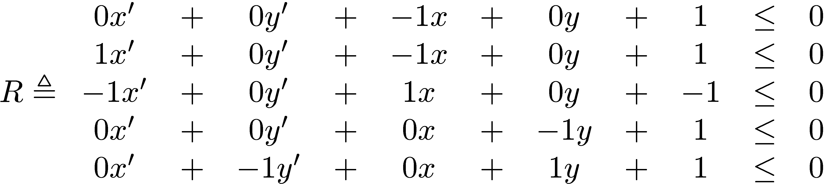
Rank function synthesis – simplified version
Search over linear templates:

Slide 91
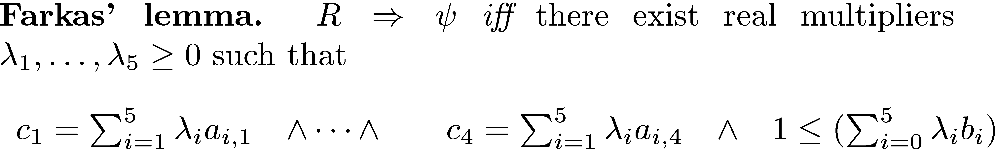
Rank function synthesis

Slide 92
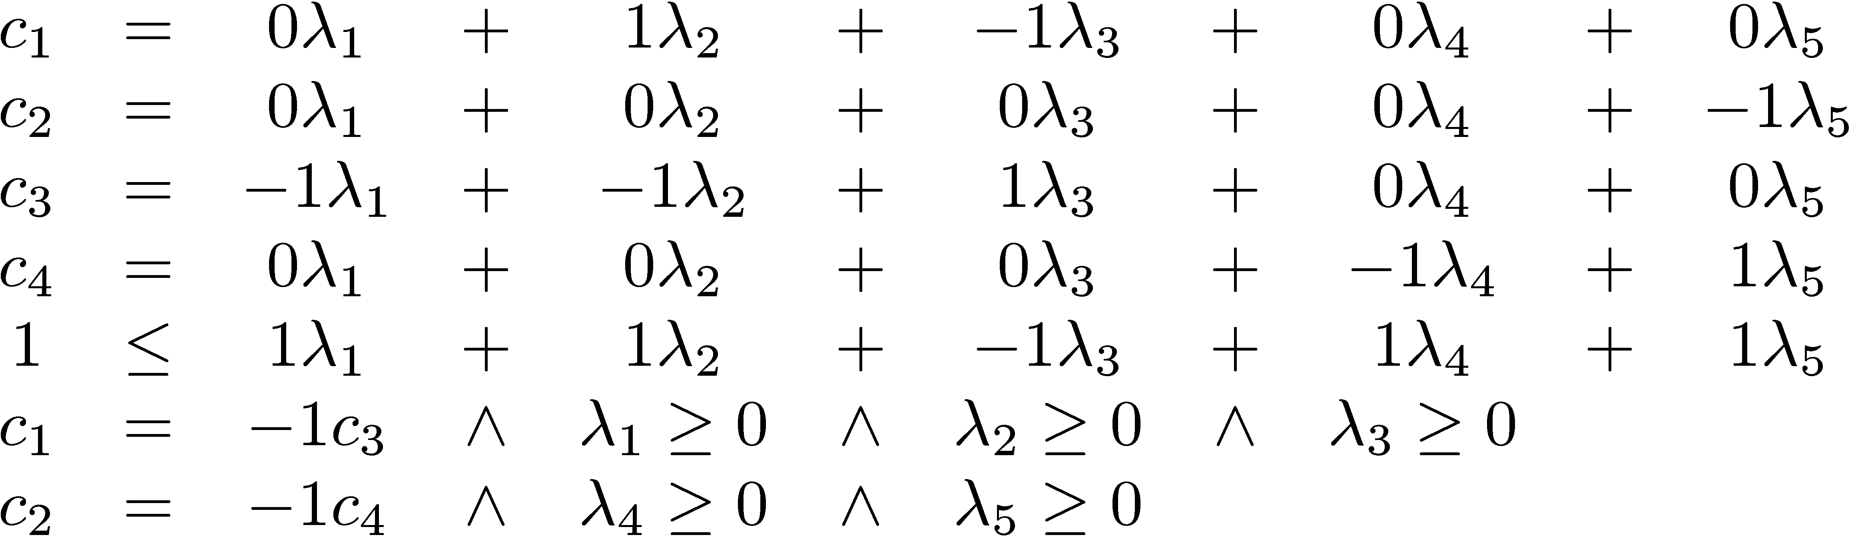
Rank function synthesis
Instead solve:

Slide 93
Rank function synthesis
Instead solve:
Solver: Dual Simplex for Th(LRA).
See Byron Cook’s blog for an F#
program that produces input to Z3

Slide 94



Program Analysis as Constraint Solving
Sumit Gulwani, Saurabh Srivastava, Ramarathnam Venkatesan, PLDI 2008

Slide 95
Loop invariants
Θ
while (c) {
S
}
Post
How to find loop invariant I ?

Slide 96
Loop invariants
Assume I is of the form ∑_{j} a_{j}x_{j} ≤ b
Simplified problem:

Slide 97
Loop invariants ⇒ Existential
Original:
Relaxed:
Farkas’:
Existential:

Slide 98
Loop invariants ⇒ SMT solving
Original:
Existential:
Bounded:
Bit-vectors:

Slide 99
Program Verification: Example
x := 0; y := 0;
while (x < 100)
x := x+n;
y := y+m;
{n=1 ∧ m=1} {y ≥ 100}
Invariant Template Satisfying Solution Loop Invariant
a₀ + a₁x + a₂y + a₃n + a₄m ≥ 0
b₀ + b₁x + b₂y + b₃n + b₄m ≥ 0
c₀ + c₁x + c₂y + c₃n + c₄m ≥ 0
a₂=b₀=c₄=1, a₁=b₃=c₀=-1
y ≥ x
m ≥ 1
n ≥ 1
a₀ + a₁x + a₂y + a₃n + a₄m ≥ 0
b₀ + b₁x + b₂y + b₃n + b₄m ≥ 0
a₂=b₂=1, a₁=b₁=-1
y ≥ x
m ≥ n
Invalid triple or Imprecise Template
a₀ + a₁x + a₂y + a₃n + a₄m ≥ 0
UNSAT

Slide 100
Abstract Interpretation

Slide 101
Programs as transition systems
Transition system:
⟨
L locations, V variables, S = [V → Val] states, R ⊆ L × S × S × L transitions, Θ ⊆ S initial states
ℓ_{init} ∈ L initial location ⟩

Slide 102
Abstract abstraction
Concrete reachable states: CR: L → ℘(S)
Abstract reachable states: AR: L → A
Connections:
⊔ : A × A → A
γ : A → ℘(S) α : S → A α : ℘(S) → A where α(S) = ⊔ {α(s) | s ∈ S }

Slide 103
Abstract abstraction
Concrete reachable states: CR ℓ x ← Θ x ∧ ℓ = ℓ_{init}
CR ℓ x ← CR ℓ₀ x₀ ∧ R ℓ₀ x₀ x ℓ
Abstract reachable states:
AR ℓ x ← α(Θ(x)) ∧ ℓ = ℓ_{init}
AR ℓ x ← α(γ(AR ℓ₀ x₀) ∧ R ℓ₀ x₀ x ℓ)
Why? fewer (finite) abstract states

Slide 104
Abstraction using SMT
Abstract reachable states:
AR ℓ_{init} ← α(Θ)
Find interpretation M: M ⊨ γ(AR ℓ₀ x₀) ∧ R ℓ₀ x₀ x ℓ ∧ ¬γ(AR ℓ x)
Then:
AR ℓ ← AR ℓ ⊔ α(x^{M})

Slide 105
Abstraction: Linear congruences
States are linear congruences: A V = b mod 2^{m}
V is set of program variables.
A matrix, b vector of coefficients [0.. 2^{m}-1]
King & Søndergård, CAV 08
Seidl& Olm, SAS 06

Slide 106
Example
When at ℓ₂ :
y is 0.
c contains number of bits in x.
ℓ₀: y ←x; c ←0; ℓ₁: while y != 0 do [ y ←y&(y-1); c ← c+1 ]
ℓ₂:

Slide 107
Abstraction: Linear congruences
States are linear congruences:
As Bit-vector constraints (SMTish syntax):
(and (= (bvadd (bvmul 010 x₀) (bvmul 011 x₁)) 001) (= (bvadd x₀ x₁) 011) )

Slide 108
Bit-vector decision procedures
Add slides describing encoding of bit-vectors in Z3

Slide 109
Abstraction: Linear congruences
(A V = b mod 2^{m} ) ⊔ (A’ V = b’ mod 2^{m})
Combine:
Triangulate
Project on x
Extra slide

Slide 110
Bounded Model Checking of
Model Programs
Margus Veanes
FORTE 08

Slide 111

Protocols
Sample protocol document for
SMB2 (a network file protocol)
Documentation
In close sync with regulatory agencies in US and EU
200+ protocols in Windows alone
~ 20 000 pages of documentation
Scope is extending (Office, ..)
Test
“Clean room” approach
External vendors do test suite development
Effort est.: 200 man-years
Sweet spot for model-based testing and verification.
% pages
Adapter for testing
Scenarios (slicing)
Behavioral modeling
Scenarios (slicing)

Slide 112
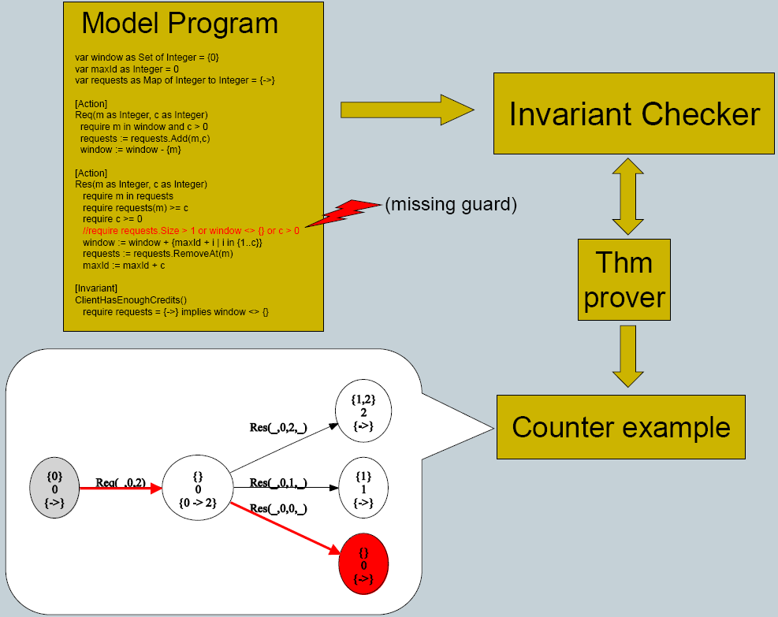
Symbolic Reachability
112

Slide 113
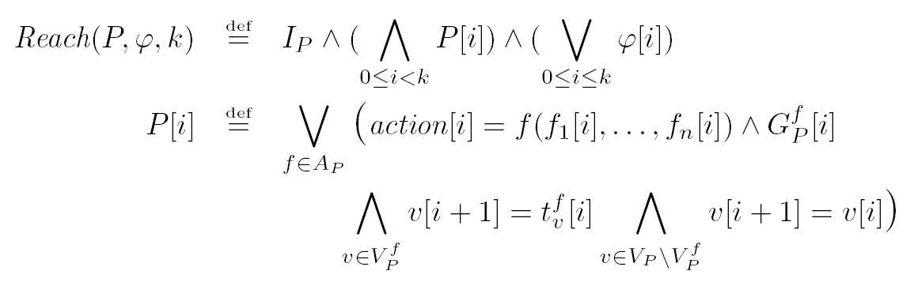
Bounded-reachability formula
Given a model program P step bound k and reachability condition φ

Slide 114
Array model programs and quantifier elimination
Array model programs use only maps with integer domain sort.
For normalizable comprehensions universal quantifiers can be eliminated using a decision procedure for the array property fragment [Bradley 06]

Slide 115
Implementation using the SMT solver Z3
Set comprehensions are introduced through skolem constant definitions using support for quantifiers in Z3
Elimination of quantifiers is partial.
Model is refined if a spurious model is found by Z3.
A spurious model may be generated by Z3 if an incomplete heuristic is used during quantifier elimination.

Slide 116
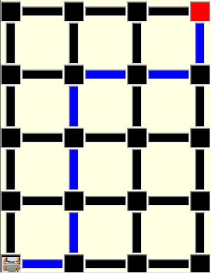
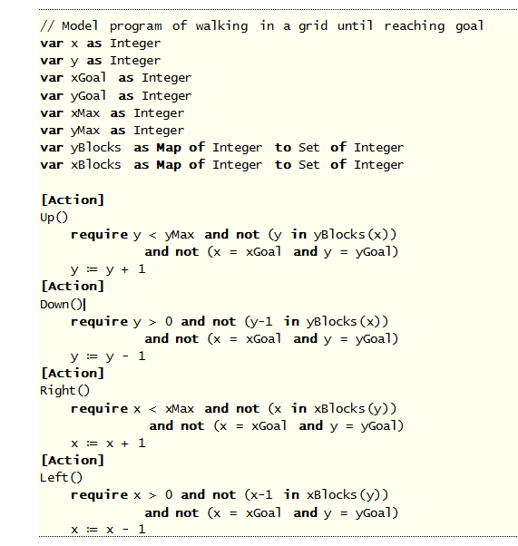
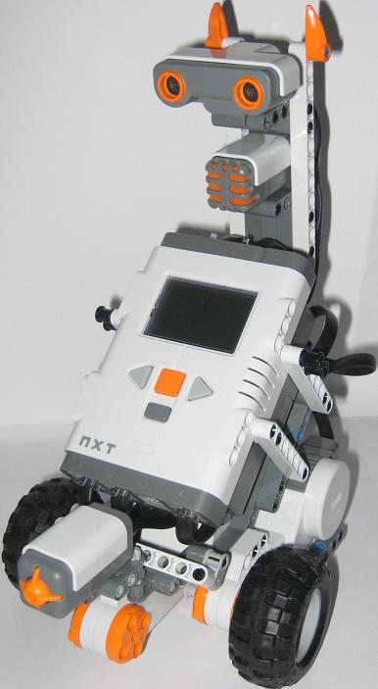
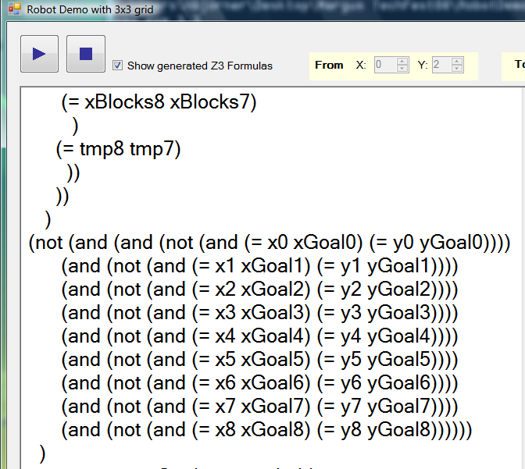
A different example: Adaptive Planning with Finite Horizon Lookahead
Model program:
Finish
Plan
Start

Slide 117
Verifying Garbage Collectors
Chris Hawblitzel
http://www.codeplex.com/singularity/SourceControl/DirectoryView.aspx?SourcePath=%24%2fsingularity%2fbase%2fKernel%2fBartok%2fVerifiedGCs&changeSetId=14518

Slide 118
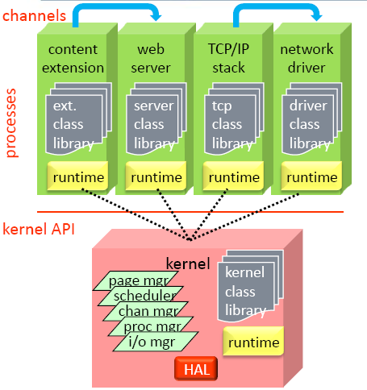
Context
Singularity
Safe micro-kernel
95% written in C#
all services and drivers in processes
Software isolated processes (SIPs)
all user code is verifiably safe
some unsafe code in trusted runtime
processes and kernel sealed at execution
Communication via channels
channel behavior is specified and checked
fast and efficient communication
Working research prototype
not Windows replacement
shared source download
Bartok
MSIL → X86 Compiler
BoogiePL
Procedural low-level language
Contracts
Verification condition generator
Garbage Collectors
Mark&Sweep
Copying GC
Verify small garbage collectors
more automated than interactive provers
borrow ideas from type systems for regions

Slide 119
Goal: safely run untrusted code
MSIL
MSIL: MSFT Intermediary Language
untrusted
code
compiler
typed x86
I/O
exception
handling
garbage
collector
trusted computing
base
(minimize this!)
linker, loader
safety verifier

Slide 120
Mark-sweep and copying collectors
abstract
graph
A
(root)
B
C
mark-sweep
copying from
copying to
A
A
A
C
C
B
B
B

Slide 121
Garbage collector properties
safety: gc does no harm
type safety
gc turns well-typed heap into well-typed heap
graph isomorphism
concrete graph represents abstract graph
effectiveness
after gc, unreachable objects reclaimed
termination
efficiency
verified
not
verified

Slide 122
Proving safety
abstract
graph
absEdge
A
(root)
B
C
toAbs
toAbs
concrete
graph
heapData
A
B
procedure GarbageCollectMs()
requires MsMutatorInv(root, allocated, colors, toAbs, absEdge, heapData);
modifies allocated, heapData, colors, toAbs;
ensures MsMutatorInv(root, allocated, colors, toAbs, absEdge, heapData);
{
call Mark(root);
call Sweep();
}
function MsMutatorInv(...) returns (bool) {
Injective(toAbs) && inHeap(root) && toAbs[root] != absNone
&& (forall i:int::{inHeap(i)} inHeap(i) ==> ObjInv(i, toAbs, absEdge, heapData))
&& (forall i:int::{inHeap(i)} inHeap(i) ==> colors[i] == white)
&& (forall i:int::{inHeap(i)} inHeap(i) ==> (toAbs[i] != absNone <==> allocated[i])) }
function ObjInv(...) returns (bool) { inHeap(i) && toAbs[i] != absNone ==>
... toAbs[heapData[i, field1]] != absNone ...
... toAbs[heapData[i, field1]] == absEdge[toAbs[i], field1] ... }

Slide 123
Using and controlling triggers

Slide 124



Refinement Types for
Secure Implementations
http://research.microsoft.com/F₇
Jesper Bengtson,
Karthikeyan Bhargavan,
Cédric Fournet,
Andrew D. Gordon,
Sergio Maffeis
CSF 2008

Slide 125
Verifying protocol reference implementations
Executable code has more details than models
Executable code has better tool support: types, compilers, testing, debuggers, libraries, verification
Using dependent types: integrate cryptographic protocol verification as a part of program verification
Such predicates can also represent security-related concepts like roles, permissions, events, compromises, access rights,...

Slide 126
Example: access control for files
Un-trusted code may call a trusted library
Trusted code expresses security policy with assumes and asserts
Each policy violation causes an assertion failure
F₇ statically prevents any assertion failures by typing
type facts = CanRead of string | CanWrite of string
let read file = assert(CanRead(file)); …
let delete file = assert(CanWrite(file); …
let pwd = “C:/etc/passwd””
let tmp = “C:/temp/temp”
assume CanWrite(tmp)
assume ∀x . CanWrite(x) →CanRead(x)
let untrusted() =
let v1 = read tmp in // ok
let v2 = read pwd in //CanRead(pwc)
// assertion fails

Slide 127
Access control with refinement types
val read: file:string{CanRead(file)} → string
val delete: file:string{CanDelete(file)} → unit
val publish: file:string → unit{Public(file)}
Pre-conditions express access control requirements
Post-conditions express results of validation
F₇ type checks partially trusted code to guarantee that all preconditions (and hence all asserts) hold at runtime

Slide 128
DSL models with FORMULA
Ethan Jackson

Slide 129
Z3 -An Efficient
SMT Solver

Slide 130
Main features
Linear real and integer arithmetic.
Fixed-size bit-vectors
Uninterpreted functions
Extensional arrays
Quantifiers
Model generation
Several input formats (Simplify, SMT-LIB, Z3, Dimacs)
Extensive API (C/C++, .Net, OCaml)

Slide 131
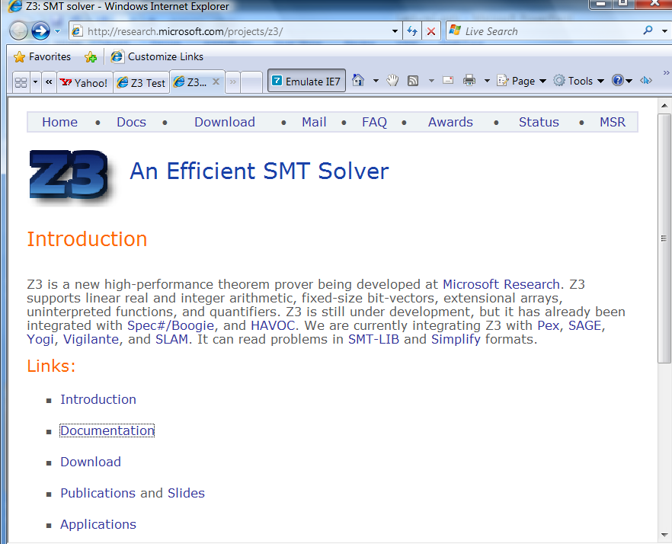
Web

Slide 132
Supporting material
http://research.microsoft.com/projects/z3/documentation.html

Slide 133
Z3: Core System Components
Text
C
.NET
OCaml
Theories
Bit-Vectors
Rewriting Simplification
Arithmetic
Arrays
E-matching
Core Theory
Partial orders
Tuples
SAT solver

Slide 134
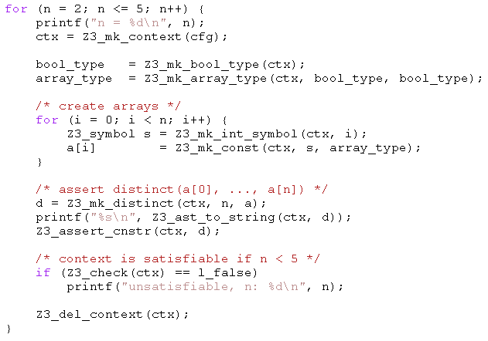
Example: C API
Given arrays:
bool a1[bool];
bool a2[bool];
bool a3[bool];
bool a4[bool];
All can be distinct.
Add:
bool a5[bool];
Two of a1,..,a5 must be equal.

Slide 135
Example: SMT-LIB
(benchmark integer-linear-arithmetic
:status sat
:logic QF_LIA
:extrafuns ((x1 Int) (x2 Int) (x3 Int) (x4 Int) (x5 Int))
:formula (and (>= (- x1 x2) 1)
(<= (- x1 x2) 3)
(= x1 (+ (* 2 x3) x5))
(= x3 x5)
(= x2 (* 6 x4)))
)
(benchmark array
:logic QF_AUFLIA
:status unsat
:extrafuns ((a Array) (b Array) (c Array))
:extrafuns ((i Int) (j Int))
:formula (and
(= (store a i v) b)
(= (store a j w) c)
(= (select b j) w)
(= (select c i) v)
(not (= b c))
)

Slide 136
SMT-LIB syntax – basics
benchmark ::= (benchmark name [:status (sat | unsat | unknown)] :logic logic-name declaration*)
declaration ::= :extrafuns (func-decl*) | :extrapreds (pred-decl*) | :extrasorts (sort-decl*) | :assumption fmla | :formula fmla
sort-decl ::= id - identifier
func-decl ::= id sort-decl* sort-decl - name of function, domain, range
pred-decl ::= id sort-decl* - name of predicate, domain
fmla ::= (and fmla*) | (or fmla*) | (not fmla) | (if_then_else fmla fmla fmla) | (= term term) | (implies fmla fmla) (iff fmla fmla) | (predicate term*)
Term ::= (ite fmla term term) | (id term*) - function application | id - constant

Slide 137
SMT-LIB syntax - basics
Logics:
QF_UF – Un-interpreted functions. Built-in sort U
QF_AUFLIA – Arrays and Integer linear arithmetic.
Built-in Sorts:
Int, Array (of Int to Int)
Built-in Predicates:
<=, >=, <, >,
Built-in Functions:
+, *, -, select, store.
Constants: 0, 1, 2, …

Slide 138
SMT-LIB – encodings
Q: There is no built-in function for max or min. How do I encode it?
(max x y) is the same as (ite (> x y) x y)
Also: replace (max x y) by fresh constant max_x_y add assumptions: :assumption (implies (> x y) (= max_x_y x)) :assumption (implies (<= x y) (= max_x_y y))
Q: Encode the predicate (even n), that is true when n is even.

Slide 139
Quantifiers
Quantified formulas in SMT-LIB:
fmla ::= … | (forall bound* fmla) | (exists bound* fmla)
Bound ::= ( id sort-id )
Q: I want f to be an injective function. Write an axiom that forces f to be injective.
Patterns: guiding the instantiation of quantifiers (Lecture 5)
fmla ::= … | (forall (?x A) (?y B) fmla :pat { term }) | (exists (?x A) (?y B) fmla :pat { term })
Q: what are the patterns for the injectivity axiom?

Slide 140
Using the Z3 (managed) API
open Microsoft.Z3
open System.Collections.Generic
open System
let par = new Config()
do par.SetParamValue("MODEL", "true")
let z3 = new TypeSafeContext(par)
Create a context z3:
let check (fmla) =
z3.Push();
z3.AssertCnstr(fmla);
(match z3.Check() with
| LBool.False -> Printf.printf "unsat\n"
| LBool.True -> Printf.printf "sat\n"
| LBool.Undef -> Printf.printf "unknown\n"
| _ -> assert false); z3.Pop(1ul)
Check a formula
Push
AssertCnstr
Check
Pop

Slide 141
Using the Z3 (managed) API
let (===) x y = z3.MkEq(x,y)
let (==>) x y = z3.MkImplies(x,y)
let (&&) x y = z3.MkAnd(x,y)
let neg x = z3.MkNot(x)
let a = z3.MkType(“a”)
let f_decl = z3.MkFuncDecl("f",a,a)
let x = z3.MkConst(“x”,a)
let f x = z3.MkApp(f_decl,x)
Declaring z3 shortcuts, constants and functions
Proving a theorem
let fmla1 = ((x === f(f(f(f(f(f x))))) && (x === f(f(f x)))) ==> (x === (f x))
do check (neg fmla1)
(benchmark euf :logic QF_UF :extrafuns ((f U U) (x U)) :formula (not (implies (and (= x (f(f(f(f(f x)))))) (= x (f(f(f x))))) (= x (f x))))
compared to

Slide 142
Enumerating models
We want to find models for
But we only care about different

Slide 143
Enumerating models
Representing the problem
void Test() {
Config par = new Config();
par.SetParamValue("MODEL", "true");
z3 = new TypeSafeContext(par);
intT = z3.MkIntType();
i1 = z3.MkConst("i1", intT); i2 = z3.MkConst("i2", intT);
i3 = z3.MkConst("i3", intT);
z3.AssertCnstr(Num(2) < i1 & i1 <= Num(5));
z3.AssertCnstr(Num(1) < i2 & i2 <= Num(7));
z3.AssertCnstr(Num(-1) < i3 & i3 <= Num(17));
z3.AssertCnstr(Num(0) <= i1 + i2 + i3 & Eq(i2 + i3, i1));
Enumerate();
par.Dispose();
z3.Dispose();
}

Slide 144
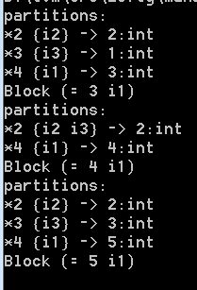
Enumerating models
Enumeration:
void Enumerate() {
TypeSafeModel model = null;
while (LBool.True == z3.CheckAndGetModel(ref model)) {
model.Display(Console.Out);
int v1 = model.GetNumeralValueInt(model.Eval(i1));
TermAst block = Eq(Num(v1),i1);
Console.WriteLine("Block {0}", block);
z3.AssertCnstr(!block);
model.Dispose();
}
}
TermAst Eq(TermAst t1, TermAst t2) { return z3.MkEq(t1,t2); }
TermAst Num(int i) { return z3.MkNumeral(i, intT); }

Slide 145
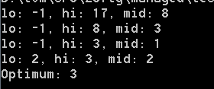
Push, Pop
int Maximize(TermAst a, int lo, int hi) {
while (lo < hi) {
int mid = (lo+hi)/2;
Console.WriteLine("lo: {0}, hi: {1}, mid: {2}",lo,hi,mid);
z3.Push();
z3.AssertCnstr(Num(mid+1) <= a & a <= Num(hi));
TypeSafeModel model = null;
if (LBool.True == z3.CheckAndGetModel(ref model)) {
lo = model.GetNumeralValueInt(model.Eval(a));
model.Dispose();
}
else hi = mid;
z3.Pop();
}
return hi;
}
Maximize(i3,-1,17):

Slide 146
Push, Pop – but reuse search
int Maximize(TermAst a, int lo, int hi) {
while (lo < hi) {
int mid = (lo+hi)/2;
Console.WriteLine("lo: {0}, hi: {1}, mid: {2}",lo,hi,mid);
z3.Push();
z3.AssertCnstr(Num(mid+1) <= a & a <= Num(hi));
TypeSafeModel model = null;
if (LBool.True == z3.CheckAndGetModel(ref model)) {
lo = model.GetNumeralValueInt(model.Eval(a));
model.Dispose();
lo = Maximize(a, lo, hi);
}
else hi = mid;
z3.Pop();
}
return hi;
}

